Slide 1
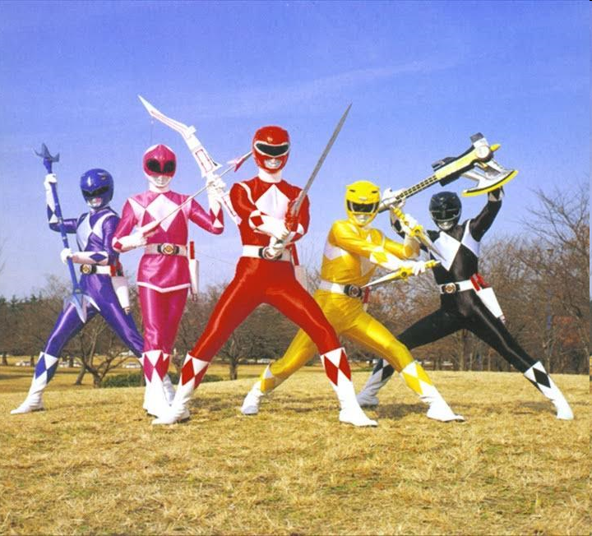
Mighty Morphin Power Ranger Toy Solution

Slide 2
Task Diagram
Period = 20ms
unsigned char elem, led;
A0
Play
Message
(Period = 20ms)
elem
Output
(Period = 20ms)
A1
B
Blink Sword
(Period = 100ms)
led

Slide 3
Play Message
Period = 20ms;
const unsigned char right_msg[3][100] = {…};
const unsigned char left_msg[150] = {…};
unsigned char i, j;
j < 100
j >= 100
/
i = (i+1)%3;
A0 && A1
A0
/
j = 0;
Right
elem = right_msg[i][j++];
Wait
j < 150
i = 0;
A0 && A1
/
j = 0;
j >= 150
Left
elem = left_msg[j++];

Slide 4
Blink Sword
Period = 100ms;
unsigned char i;
A1
A1
/
i=0;
1
i >= 30
Wait
ON
OFF
i < 30
/
i++;
led = 0;
led = 1;
led = 0;

Slide 5
Output
Period = 100ms
1
Output
B = elem & (0x7F) | (led << 7);

